Slide 1
Team A
Project 6X6 Tic Tac Toe Game

Slide 2
Introduction
Tic Tac Toe is a game that is played with two players, X and O, who take turns marking spaces usually in a 3X3 grid.
For this project the game will be change from its most common size 3x3 to a 6x6 with 4 squares require to win rather than 3.
In conclusion 6X6X4

Slide 3
Purpose of the Game
The purpose of the game is to win against a player or an Artificial intelligence.
To win, the player with most 4 square lined up wins:
Vertically
Horizontally
diagonal.
Winner will be determine after the board is filled up.
Have fun playing
Notes:
GOALS: To play the game during downtime, to be entertained and to win the game.
TASKS:

Slide 4
How the game will work
At the start of the game, you will be given a menu
This menu will show you a log on screen
User can sign in or pick to sign up.
Once you have your username or already have one, the game will begin

Slide 5
User Requirement
user requirement:
Login in as a user in order to play
Game starts as a player vs another Player
Update score as users have aligned squares
Notes:
GOALS: To play the game during downtime, to be entertained and to win the game.
TASKS:

Slide 6
New User Requirement
New User Requirement:
Register the user in order to login
Game starts as player vs Player
Update score as users have aligned squares

Slide 7
Special case of Player vs AI
Player and AI:
Login as a user and Choose vs AI
Game starts as player vs AI
Update score as player have aligned squares

Slide 8
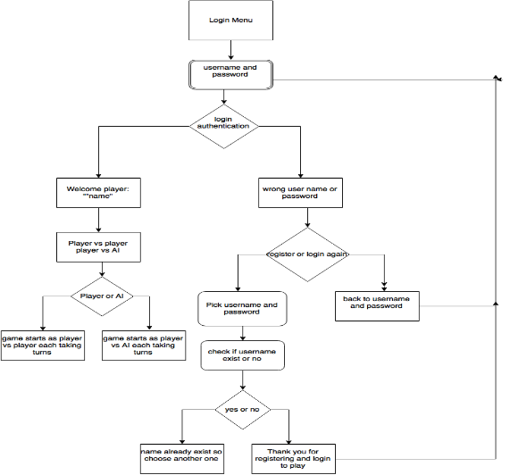
Game flow diagram

